Slide 1

Synopsis of the Thesis Entitled Scalable Multi-Model framework for Mob Behavior Analysis Ph.D. in Computer Management By Ms. Insha Meerabaksh Shaikh Under the Guidance of Dr. Imran Baig Mirza Research Guide At Allana Institute of Management Sciences Place of Research

Slide 2

Agenda
Introduction
Background
Motivation
Aims & Objectives
Literature Review
Research Gap
Problem Statement
Research Framework
Datasets
Evaluation
References

Slide 3

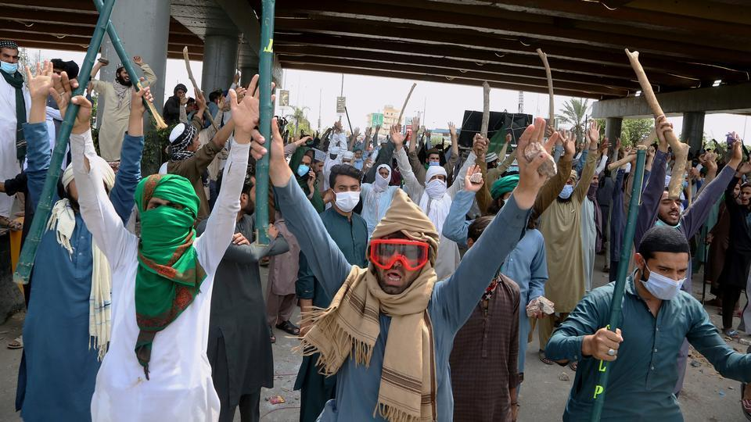
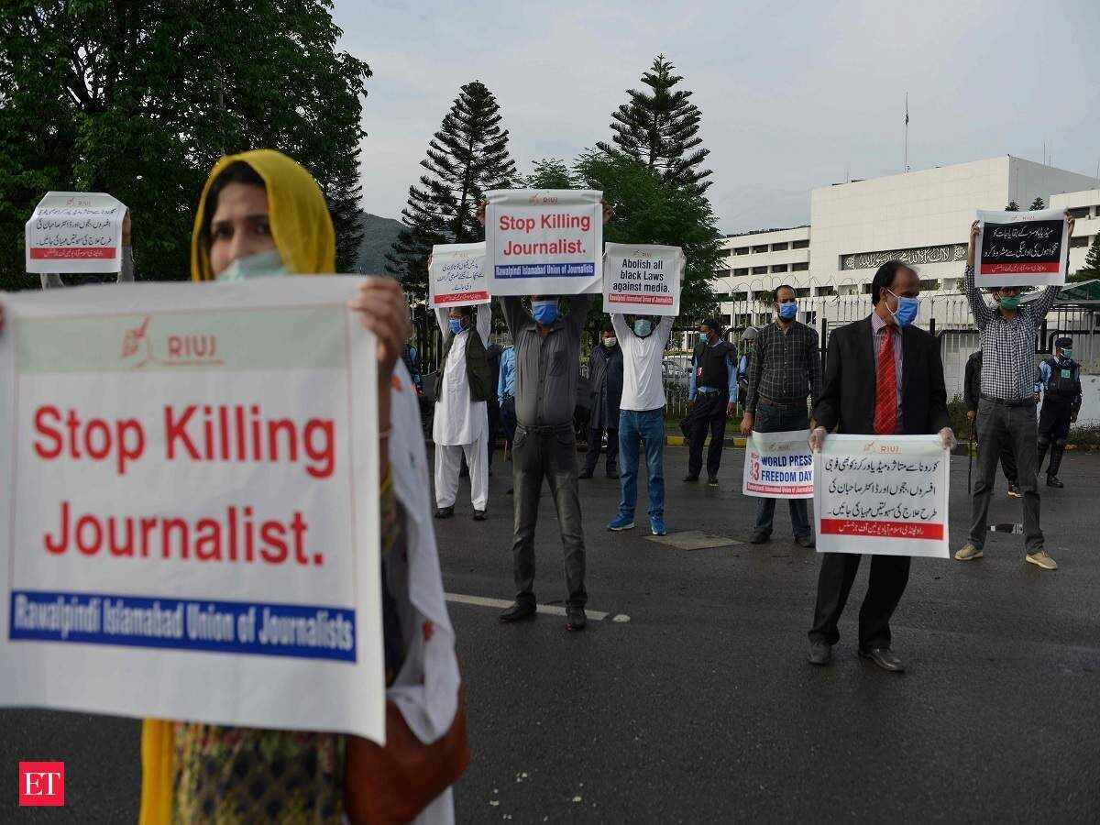
Introduction
There is a growing trends of smart cities around the world, where security situation is monitored through surveillance cameras. Proposed automation work lacks a unified framework for the mob analysis that can analyze the statistical side and behavior analysis jointly. This work will devise a behavior analysis framework that will assess the mob buildup and the nature.
Figure – Violent Mob
Figure – Peaceful Mob

Slide 4
Problem Statement
Due to lack of timely information regarding mob buildup, law enforcement agencies become active very late, meanwhile, mob blocks the roads, widely spread and become violent.
Early and real-time information regarding mob buildup will help to management it in good manner.
Real-time mob behavior analysis for law enforcement agencies to cop with relevant measure.
With the real-time road blockage, traffic police can make traffic diversion plan

Slide 5
Literature Review
Title | Year | Methodology | Dataset | Result | Objectives
Real-time crowd behavior recognition in surveillance videos based on deep learning [1] | 2022 | Yolo for detection 3DCNN for behavior | PETS 2009 | 93.07% | Crowd Counting Behaviour recognition
Trans Crowd: Weakly-Supervised Crowd Counting with Transformer [2] | 2022 | Transformer | NWPU-Crowd JHU-CROWD++ ShanghaiTech | 92.2% | Crowd Counting
Multi-Person Tracking in Smart Surveillance System for Crowd Counting and Normal/Abnormal Events Detection. [3] | 2021 | Gaussian Clusters for crowd analysis | PETS2009 and UMN crowd | 88.7% | Crowd counting Behavior detection
Crowd density estimation using novel feature descriptor [4] | 2020 | Support Vector Machine (SVM) | PETS 2009 | 88% | Crowd Density
End-to-end crowd counting via joint learning local and global count [5] | 2021 | CNN RNN | NWPU Crowd | 87% | Crowd counting
Table 1: Literature Review
Notes:
5

Slide 6
Literature Review
Title | Year | Methodology | Dataset | Result | Objectives
Resnet Crowd: A residual deep learning architecture for crowd counting, violent behavior detection and crowd density level classification [6] | 2019 | Multi task residual CNN for head count | ShanghaiTech | 88% | Crowd counting Crowd density
End-to-end crowd counting via joint learning local and global count [7] | 2018 | CNN RNN | NWPU Crowd | 87% | Crowd counting
Learning to predict human behavior in crowded scenes [8] | 2017 | Social force model and LSTM based networks | PETS2009 and UMN crowd | 83% | Crowd Density
Plug-and-Play CNN for Crowd Motion Analysis: An Application in Abnormal Event Detection [9] | 2017 | CNN with low level optical flow | UMN crowd | 82% | Crowd Motion
Table 1: Literature Review
Notes:
6

Slide 7
Research Gap
Although, efforts had been made to automate mob analysis process, but each work had touched single aspect of the mob like density, but lacks in the determining the mob intent with prohibited objects.

Slide 8
Aims and Objectives
To classify scenes in live streaming for mob build up, (e.g. small, middle, and large)
Mob analysis for making predictions for potential behaviors like growth, dispersion, peacefulness and restlessness.
Violence assessment based on prohibited objects (e.g. Stick)
Identification of road blockage by the mob
Figure 1 – Violent Mob
Figure 2 – Peaceful Mob

Slide 9
Scope
Object detection
Person
Weapon
Sticks
Placards
Fire
Mob build up identification and growth rate assessment
Area Classification into road and non-road categories
Mob Behavior assessment

Slide 10
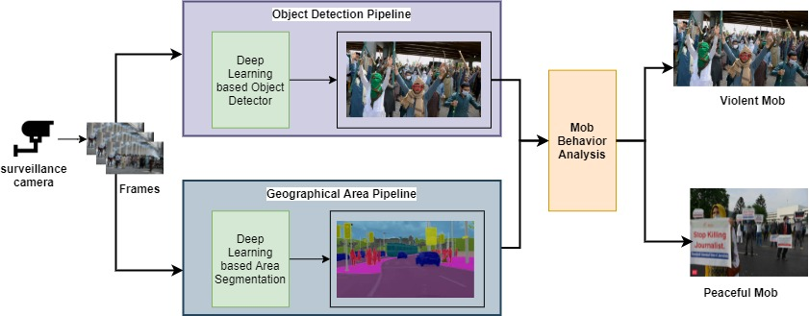
Research Methodology
Proposed framework can be described as:
Mob volume assessment based on person detection
Detection of set of other objects for mob-object interaction
Area categorization.
Road blockage identification

Slide 11
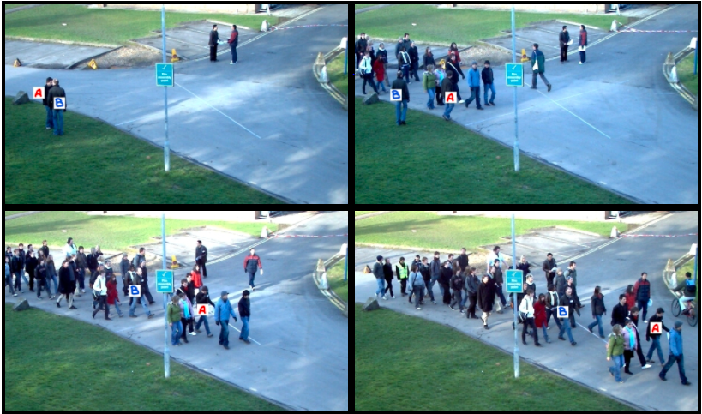
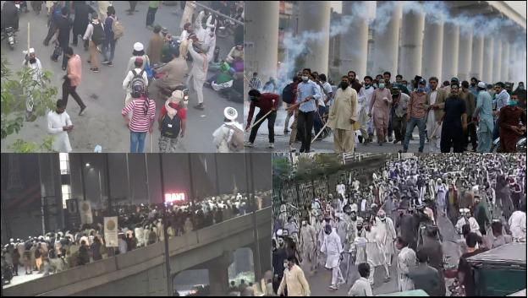
Datasets
JHU-CROWD++
Contains 4,372 images (with an avg. resolution of 1430x910) collected under a control environment.
Self-created dataset
Contains 7,500 images (with an avg. resolution of 2024x1080). Real time collected under a diverse set of conditions and various geographical locations
Figure 6 – JHU-CROWD Dataset Samples
Figure 7 – Self Collected Dataset Samples

Slide 12
Evaluation metrics
Precious - Precision is the ratio of correctly predicted positive observations to the total predicted positive observations.
Recall - Recall is the ratio of correctly predicted positive observations to the all observations in actual class
Accuracy - Accuracy is the most intuitive performance measure and it is simply a ratio of correctly predicted observation to the total observations.
F1 score - F1 Score is the weighted average of Precision and Recall.

Slide 13
References
13
Alanazi AA, Bilal M. Crowd density estimation using novel feature descriptor. arXiv preprint arXiv:1905.05891. 2019 May 15.
(Shehzed A, Jalal A, Kim K. Multi-person tracking in smart surveillance system for crowd counting and normal/abnormal events detection. In2019 international conference on applied and engineering mathematics (ICAEM) 2019 Aug 27 (pp. 163-168). IEEE.
Liang D, Chen X, Xu W, Zhou Y, Bai X. TransCrowd: Weakly-Supervised Crowd Counting with Transformer. arXiv preprint arXiv:2104.09116. 2021 Apr 19.
iang D, Chen X, Xu W, Zhou Y, Bai X. TransCrowd: Weakly-Supervised Crowd Counting with Transformer. arXiv preprint arXiv:2104.09116. 2021 Apr 19.
Rezaei F, Yazdi M. Real-time crowd behavior recognition in surveillance videos based on deep learning methods. Journal of Real-Time Image Processing. 2021 May 3:1-1
Shang C, Ai H, Bai B. End-to-end crowd counting via joint learning local and global count. In2016 IEEE International Conference on Image Processing (ICIP) 2016 Sep 25 (pp. 1215-1219). IEEE.
Alahi A, Ramanathan V, Goel K, Robicquet A, Sadeghian AA, Fei-Fei L, Savarese S. Learning to predict human behavior in crowded scenes. InGroup and Crowd Behavior for Computer Vision 2017 Jan 1 (pp. 183-207). Academic Press.
Marsden M, McGuinness K, Little S, O'Connor NE. Resnetcrowd: A residual deep learning architecture for crowd counting, violent behaviour detection and crowd density level classification. In2017 14th IEEE international conference on advanced video and signal based surveillance (AVSS) 2017 Aug 29 (pp. 1-7). IEEE.

Slide 14



